Slide 1
Introduction to Matrix
Elizabeth Michael–Supplier Relationship Manager

Slide 2
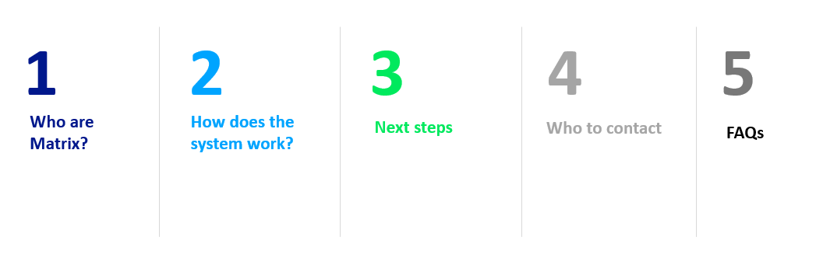
Agenda

Slide 3




Who are Matrix?
About us
As a Neutral Vendor Managed Service Provider, we specialise in managing and improving recruitment supply chains
Matrix brings Technology and People together to improve Client’s recruitment processes and supply chains
We believe temporary recruitment should be reliable, simple and fast, while reducing costs:
Using technology to ensure transparency and delivery of the best candidates
Driving savings on year-on-year spend with the support of our expert staff
Ensuring Clients receive the best value from our system and services

Slide 4

Who are Matrix?
Matrix are a market leading neutral vendor, managing temporary & permanent recruitment supply chains.
We have a network of trusted UK recruitment agencies
We manage over 17,000 temporary workers every week
Our online system Matrix-CR.Net is powerful, yet simple to use and automates the hiring process from start to finish
£680 million annual spend under management
Dedicated and proactive Supplier Engagement team
Dedicated Corporate Social Responsibility team
Matrix are a market leading Neutral Vendor, managing temporary recruitment supply chains

Slide 5
Team Matrix Overview
Our purpose is simple, we want to connect people to work.
Supplier Engagement Team
Customer Success Team
Business Management Team
Manage the Accreditation and Enrolment process.
Handle and review all supplier documentation.
Support suppliers with compliance and enrolment queries.
Own and manage relationships with suppliers.
Analyse and review the supply chain.
Host events and forums.
Support suppliers with operational and system queries.
Responsible for ensuring that Orders are filled on time with suitable candidates.
Handle and review all pre-employment compliance checks.
Manage the day-to-day relationships between our Clients and the supply chain.
Strategic focus on building supply chains for our Clients.
Gather market intelligence and work collaboratively with Clients and Suppliers to find solutions to any challenges.
Manage relationships with our principal suppliers.
Focus on improvement strategies for hard to fill roles.

Slide 6





Our Clients
We work in partnership with:
Local Authorities – 90
Private Care – 9
Retail – 1
Other – 9
Self-managed – 4

Slide 7

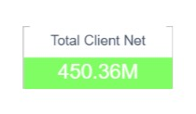
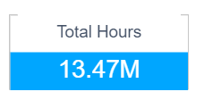
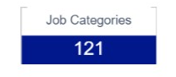
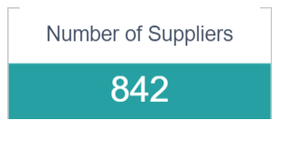
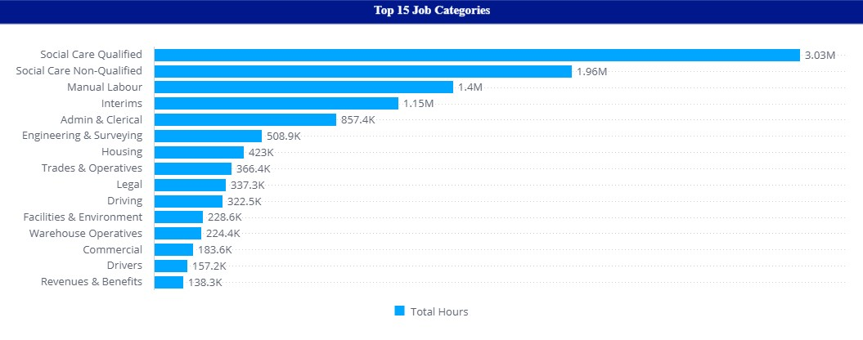
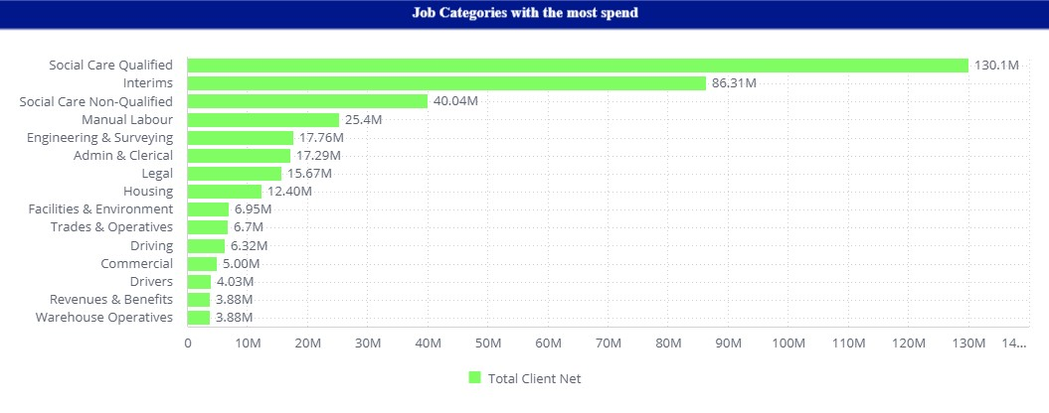
Preview - Last 6 Months

Slide 8
How does the system work?
The End-to-End Process
A vacancy or shift requires filling.
New order is created, or a shift is added to existing shift order.
Suppliers receive an email notification.
Suppliers submit candidates for consideration
OR
Add shifts to an existing placement.
Timesheets are approved by the Hiring Manager and invoiced automatically.
Timesheets are submitted on the Matrix System or Timesheet App.
Hiring manager accepts a candidate and their placement is created
OR
Hiring Manager approves a shift on a placement.
Notes:
System and process allows full transparency of compliance, rates, hours worked etc. Self-bill function removes the need to raise and chase POs/invoices. All invoices remain accessible on the system

Slide 9

Benefits of working with Matrix?
Easy access to review roles and requirements
Opportunities to supply to our network of Customers
Focus on the quality of candidates
Easy timesheet submission and approval process
Automated invoicing and payments. No requirement for PO’s.
All information is stored on the system for Auditing purposes
We operate 24 hours per day / 365 days per year
Instant access to online training videos and compliance guides
Free Live Support Service Available
Regular Supplier Training Sessions

Slide 10




Recent Developments
Compliance
Technology
Payroll
Notes:
- Acquired Security Watchdog in June 2023 to increase Matrix offering to both clients and suppliers around compliance.
- New bespoke system in process of being built. More streamlined processes and enhanced features. SW compliance products to be incorporated
- Matrix Umbrella launched. Offering a trusted and transparent alternative to current umbrella companies

Slide 11

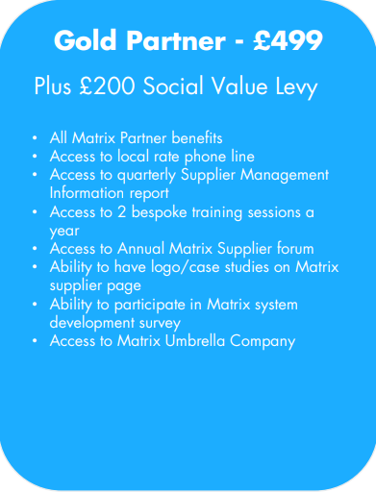
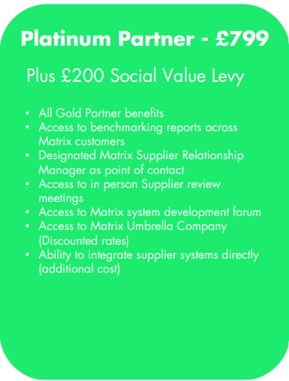
Matrix Partners
Notes:
We have introduced different Supplier memberships.
Is what every supplier gets
You can upgrade to the Gold Partner membership which provides you with extra benefits
You can also upgrade to the Platinum Partner membership for maximum benefits
Comes into effect on the 2nd October
Current suppliers will only pay the £99 when their Self-Bill renews
Any questions about this or you would like to upgrade before your Self-Bill needs renewing, please contact the Supplier Engagement team

Slide 12

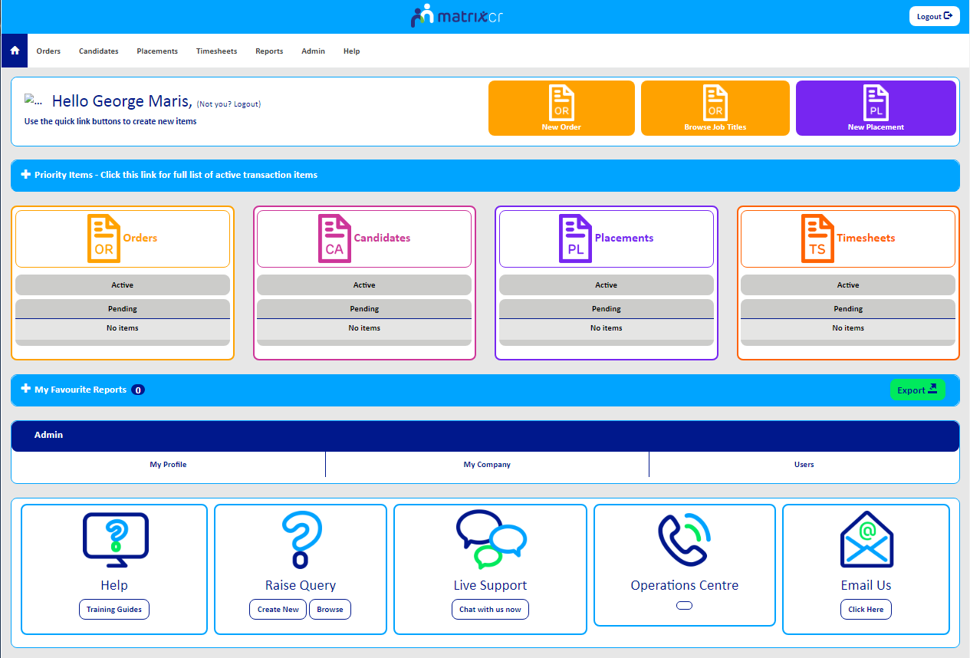
Next Steps
Accreditation
Supplier Agreement
Enrolment
Supplier Addendum
Supplier Training Session
https://matrix-suppliertraining.eventbrite.co.uk
Notes:
Both temp and perm

Slide 13
Who to Contact
We are here to help and support you.
Supplier Engagement Team
supplier.engagement@teammatrix.com

Slide 14
FAQs
Rates/margins
Compliance Guides
Timesheet submissions
Timesheet approval
Weekly invoicing schedule
Communication channels
Supplier System Training - https://matrix-suppliertraining.eventbrite.co.uk
Notes:
Rates listed on all orders. Margins listed on all client addendums
Guides can be found under Help > Training Resources on CR.Net
Timesheets need to be submitted by worker/supplier and approved by manager by 23:59 every Tuesday. All approved timesheets invoiced and self-bill ready by Friday that week. Unapproved timesheets not included in self-bill and will roll over to following week
Customer Success Team can be contacted through the live support function and provide instant support with any queries.
Supplier training held every 2 weeks

